Slide 1
WEB 322 WEB PROGRAMMING TOOLS AND FRAMEWORKS
Week 12 – Lecture 1
Security

Slide 2
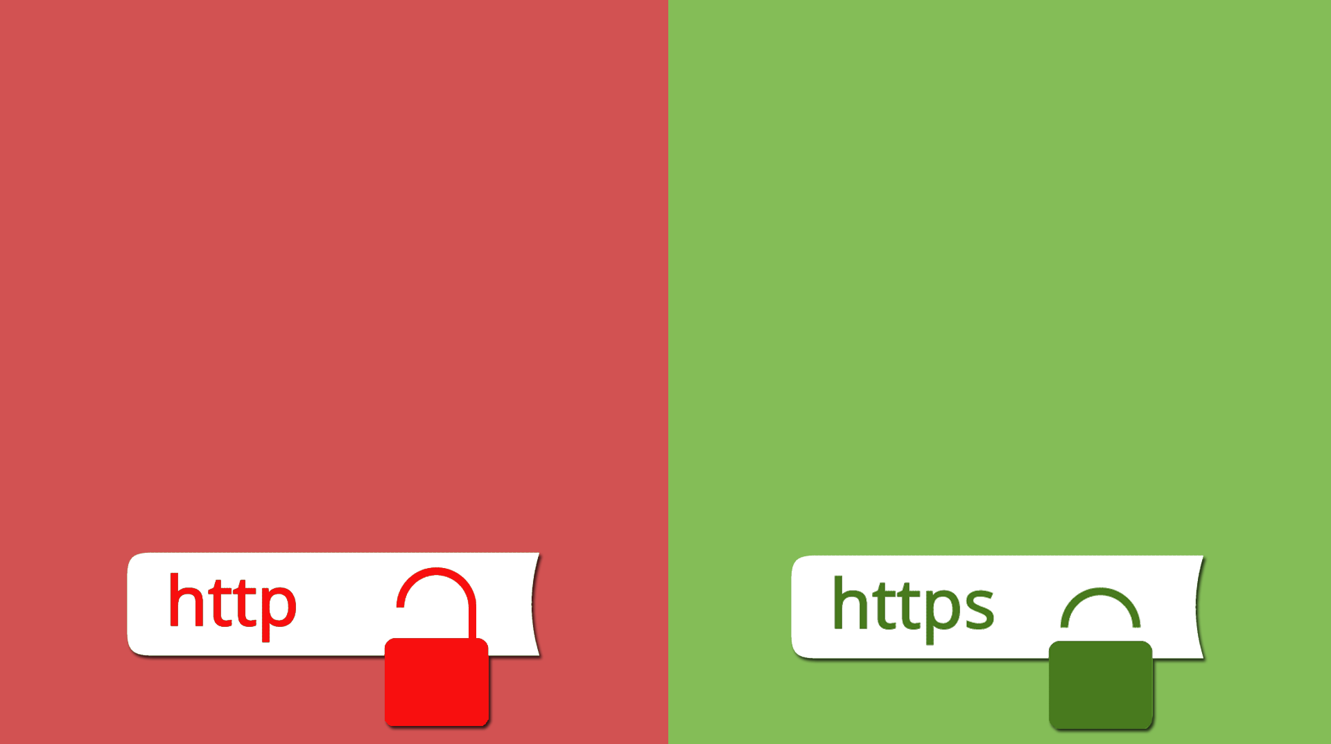
HTTPS
HTTP communication over a secure, encrypted connection.
Uses TLS (Transport Layer Security)
SSL/TLS certificates are used by the server to encrypt the communication between the client and the server.
Packets intercepted cannot be understood by an attacker, the “man in the middle” attack.

Slide 3

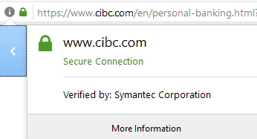
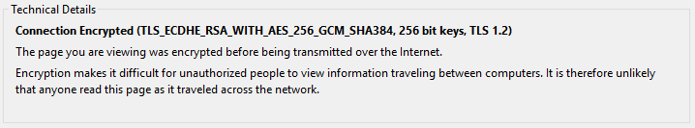
Verified Security
Look for a lock icon by the URL bar in your browser.
Click it to view details about the SSL/TLS certificate.
A trusted entity must sign the certificate. This entity should vet the certificate holder and ensure they are who they claim to be.

Slide 4
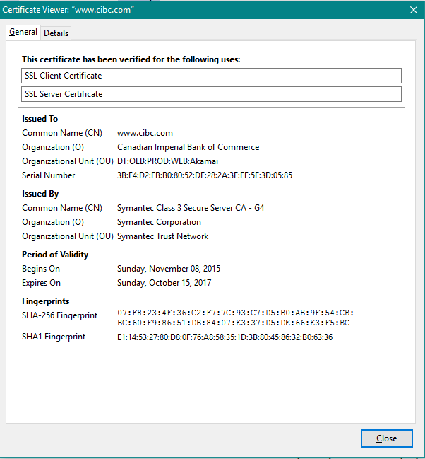
Full certificate details

Slide 5

Who do you trust?
Symantec, GoDaddy, VeriSign, Comodo, and many more.
These are certificate authorities.
They have root certificates that other certificates are generated under.
Browsers already know these root certificates and constantly keep track as they are added, expired or untrusted.

Slide 6
Self-Signed certificates
SSL/TLS certificates can be created and used without a signing authority.
Using self-signed certificates will show a warning in the browser.
These are considered ‘untrusted’ since ‘anyone’ can create their own certificate that has not been vetted.
Even though they are untrusted, they still do what certificates do (encrypt).
Great for development, but not good enough for production.

Slide 7

Creating a self-signed certificate
There are many tools available for creating SSL/TLS certificates.
OpenSSL is a popular, full-featured SSL/TLS tookit.
OpenSSL is included with GIT if you installed it. Run “GIT Bash”.
openssl req -new -x509 -nodes -out server.crt -keyout server.key
req: Request a certificate
-new: This is a new request
-x509: Output a x509 structure instead of a certificate request
-nodes: Don’t encrypt the output key
-out server.crt: Save the request to the file “server.crt”
-keyout server.key: Save the key to the file “server.key”.

Slide 8
Creating a self-signed certificate
You are asked to enter information about the website owner (your company?)
2-Letter Country Code – Example: CA
State/Province – Example: ON
City (aka Locality) – Example: Toronto
Company Name (aka Organization Name) – Example: Seneca College
Department (aka Organizational Unit Name) – Example: ITS
Common Name (aka FQDN) – Example: localhost
The common name should match the full URL to your website. The port number is excluded.

Slide 9
How HTTPS encryption works
Your browser reaches out to the web server and requests a connection.
The web server sends you its public key. It keeps its private key a secret.
Your browser generates a third key called a session key. The session key is encrypted by your computer using the public key you got from the server
The encrypted session key is then shared with the server.
The server decrypts the session key that it received from you using the secret private key. Now both ends have the session key that your computer generated.
The public key encryption is no longer needed and is instead replaced with symmetric encryption. Symmetric encryption is used until you leave the website (close your browser).

Slide 10

Using a self-signed certificate in Node.js

Slide 11
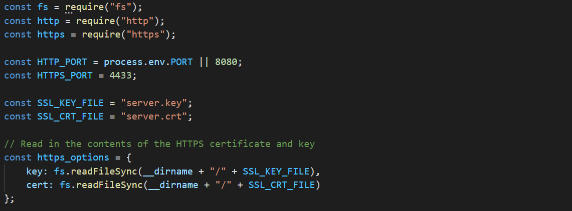
Require and configure HTTPS

Slide 12
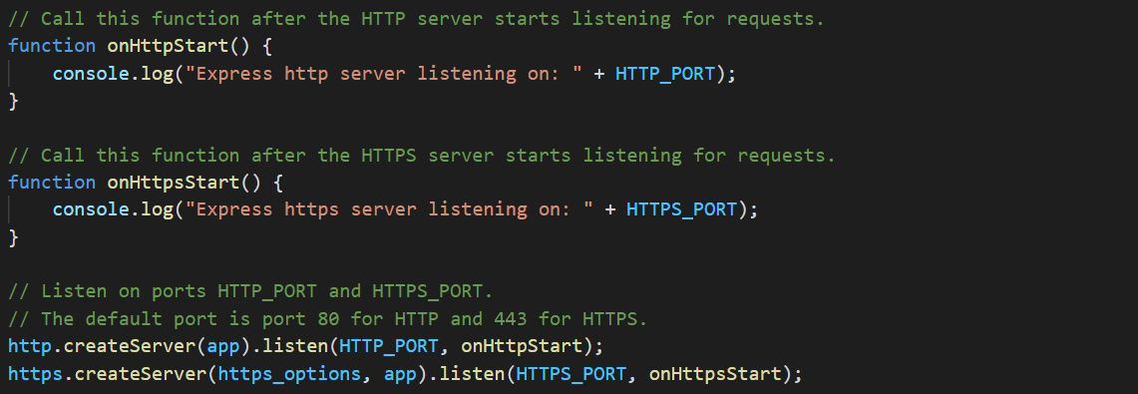
Start the HTTP and HTTPS servers

Slide 13
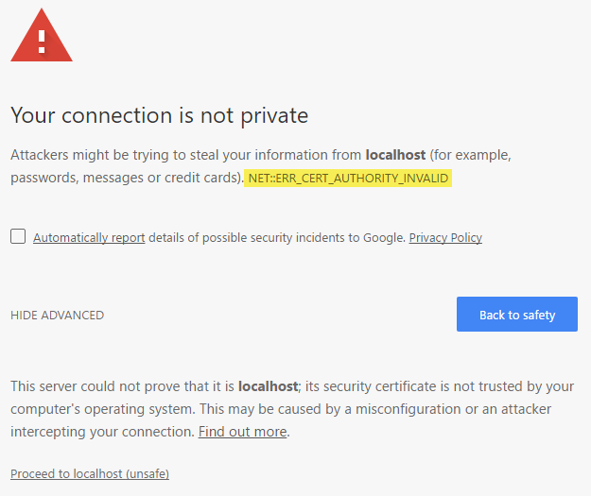
Testing your website
Start “node” and connect to your website using your favourite browser.
You will get a security warning, why?
If using Firefox, you can add an exception.
On Windows, you can also install the certificate to trust it.

Slide 14

An open-source project overseen by The Linux Foundation
https://letsencrypt.org/
Offers free SSL/TLS certificates from a trusted Certificate Authority.
Other’s charge for this service, some even in the range of thousands of dollars.
Why free?
To “support a more secure and privacy-respecting Web”.
Root certificates are trusted by most major web browsers.
You must renew the certificates every 90 days.
Uses ACME (Automatic Certificate Management Environment) protocol to prove identity.

Slide 15
Using Let’s Encrypt with Node.JS
It requires a custom domain that is publicly available on the web.
Let’s Encrypt servers will connect your server to issue a certificate.
We are hosting on Heroku, so our apps are already SSL-enabled.
No custom domain: https://appname.herokuapp.com
What about custom domains?
https://www.yourdomain.com
Check out greenlock-express and greenlock-cli.
Also check out the Let’s Encrypt documentation.

Slide 16


